Slide 1

Submitted By: Jaspreet Kaur Bajwa 81002107029
Development Of Soil Nutrient Prediction Model Using Pattern Recognition Techniques

Slide 2


Details about the organization:
Organization : Central Scientific Instruments Organisation (CSIO)
Department : Agrionics
Guide : BabanKumar S. Bansod (Senior Scientist)

Slide 3

Objective of the project
To develop a real time soil sensor which will allow the automated collection of soil nutrient data to accurately characterize within-field variability for site-specific fertilizer application.
In addition, the sensor will provide accurate maps of soil nutrients, so that geo-referenced nutrient applications can be made with precision. This comes under the new technology known as ‘Precision Agriculture’.

Slide 4
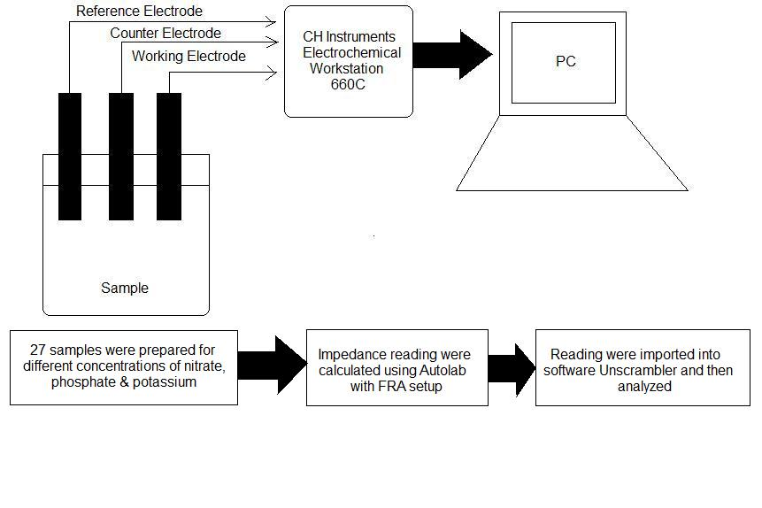
Experimental Details
The lab samples were prepared which match the characteristics of soil mixture. The data was collected using the technique known as ‘Electrochemical Impedance Spectroscopy’ using Gold as the working electrode. The data was imported into the computer & analysed using the multivariate analysis software ‘Unscrambler’. I was working on the software side of the project & performed data analysis.

Slide 5

Technologies Used
Pattern Recognition
Electrochemical Impedance Spectroscopy
Cluster Analysis

Slide 6
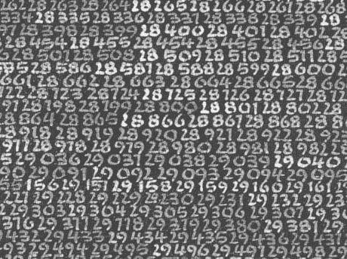
Pattern Recognition
It is defined as a classification of input data via extraction important features from a lot of noisy data.
It is a scientific discipline whose aim is the classification of the objects into a lot of categories or classes.
TECHNIQUES USED:
Support vector machines
Neural networks
K-means clustering
Regression algorithms
Principal component analysis (PCA)

Slide 7
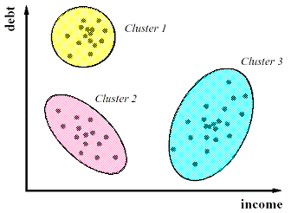
Clustering
The aim of clustering analysis is to group a given data set into clusters. A resulting partition should possess the following properties:
Homogeneity within the clusters, i.e., data that belong to the same cluster should be as similar as possible and
Heterogeneity between the clusters, i.e., data that belong to different clusters should be as different as possible.

Slide 8

Software Used For Performing Analysis (Unscrambler 10.2X)
It provide tools which can help one to analyze multivariate data. This involves finding variations, co-variations and other internal relationships in data matrices (tables).
Consists of tools that prove to be beneficial during the analysis like:
PCA (Principal Component Analysis)
SVM (Support Vector Machine)
Regression analysis
Prediction tools
Clustering techniques

Slide 9
Flow Chart of the analysis performed
To establish discriminability between the samples
Classification of the samples into different classes
Mapping the unknown soil sample into these classes so that it's behaviour can be accurately judged
Regression analysis of the unknown sample with the class identified to predict it's concentration
Validating the results
Cluster analysis

Slide 10
Principal Component Analysis (PCA)
PCA is a statistical technique for the reduction of input data dimension and is largely used for feature extraction.
It captures the relevant information in a set of input data providing a lower dimension, but informative representation of the original data.
It sequentially creates a set of principal components from the original data. The first principal component (PC1) maps the maximum variance and information of the input data followed by the other principal components (PC2, PC3 and so on) in descending order of the variance. Generally a good discrimination is mapped by the first two principal components, i.e. PC1 and PC2.

Slide 11

Establishing discriminability of the samples with the help of PCA

Slide 12
Group 6 (N3 & K1)
Group 4 (N3 & K3)
Six distinct groups have been identified based on the ions & the concentrations. There are 3 ions under investigation: Nitrate (N), Phosphate (P) & Potassium (K). Similarly there are 3 conc. Levels i.e. Low denoted by subscript 1, middle denoted by subscript 2 & high denoted by subscript 3.
Group 5 (N3 & K2)
Group 3 (K1)
Group 2 (K2)
Group 1 (K3)

Slide 13
Classification of the unknown samples into groups (clusters) using Support Vector Classification (SVM)
SVM is a classification method based on statistical learning wherein a function that describes a hyper plane for optimal separation of classes is determined. As the linear function is not always able to model such a separation, data are mapped into a new feature space and a dual representation is used with the data objects represented by their dot product.

Slide 14
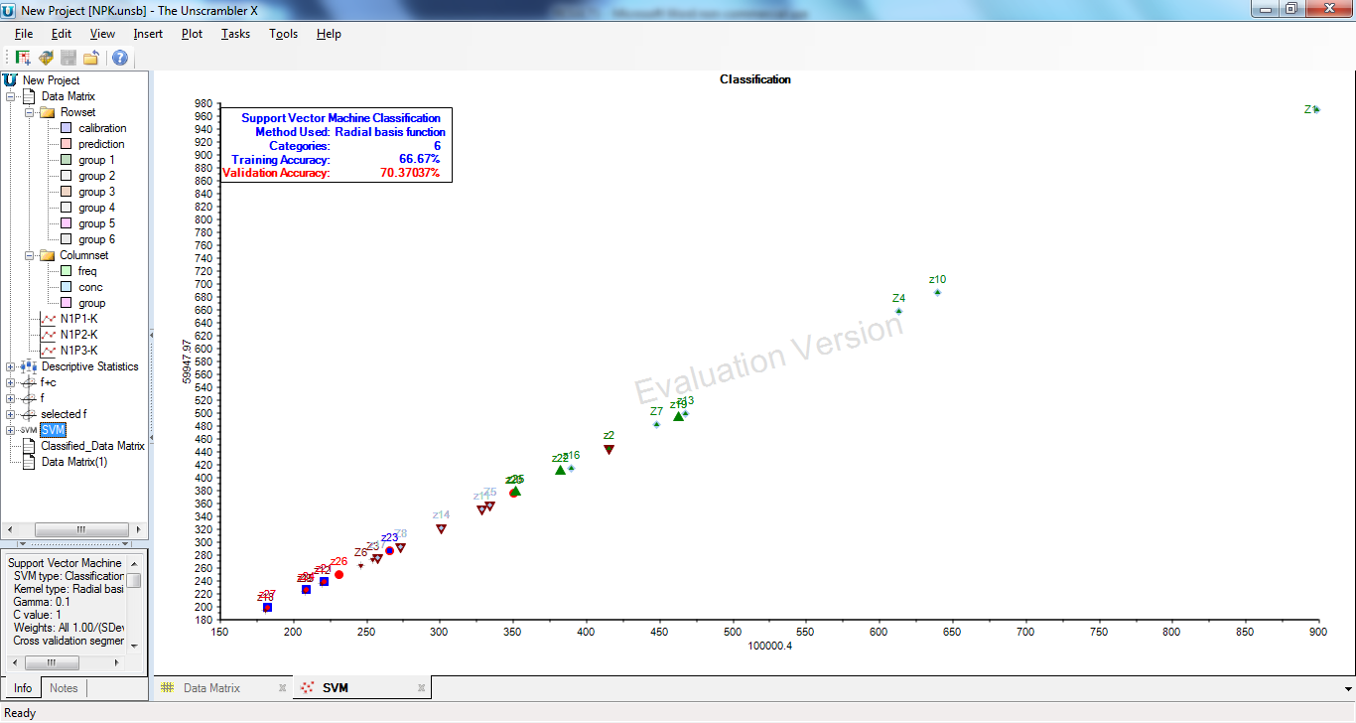
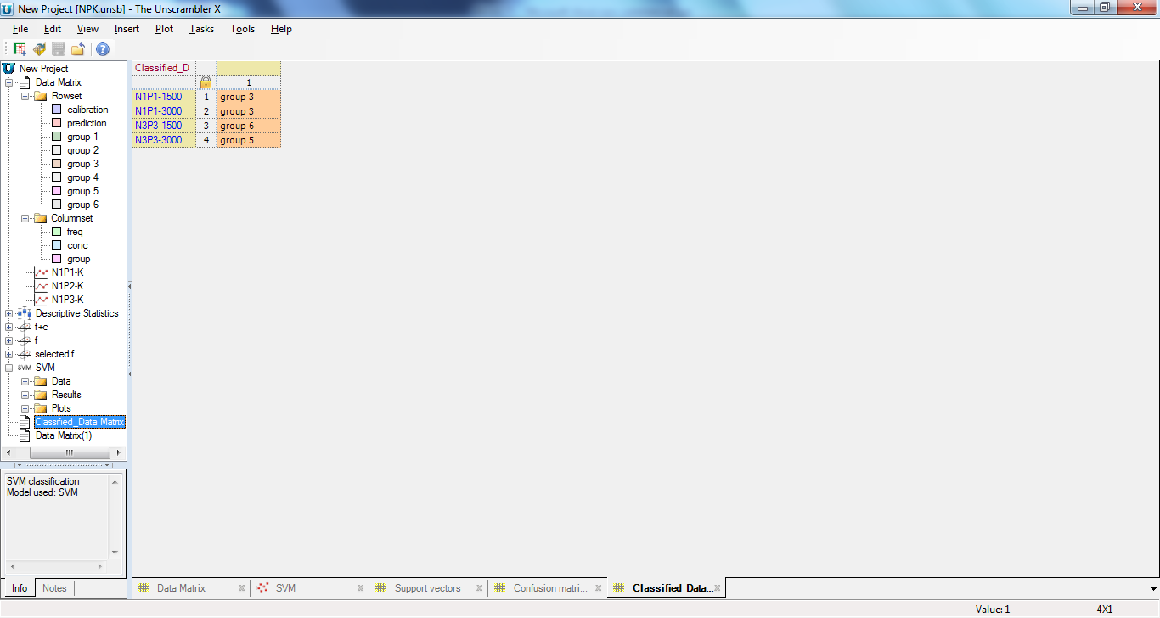
SVM model is training the system with 67% accuracy & the results are validated up to 70%. The percentages can be improved using various normalization techniques.
4 unknown samples are classified using the tool Support Vector Machine classification & the results are found to be correct up to 75%. These are the lab unknown samples that were prepared with varying known concentration so that the results can be validated.
Group 3 comprises of samples having Potassium as low level which is close to 1500.
Group 5 comprises of samples having high conc. of nitrate ion & low potassium level whereas Group 6 comprises of samples having high conc. of nitrate ion & middle potassium level.

Slide 15
Regression Analysis
The purpose of performing regression analysis is to predict the concentration of the unknown samples. The concentration of potassium ion is being varied hence identifying the accurate concentration of the samples to an approximate level is our aim.

Slide 16
Idea Behind Regression Analysis
Prediction requires a regression model (MLR, PCR or PLS) which expresses the response variable(s) (Y) as a function of the X-variables.
The model should have been ‘calibrated’ on samples covering the same region the new samples belong to, i.e. on similar samples (similarity being determined by the X-values).
The model should have been ‘validated’ on samples covering the region the new samples belong to, preferably using test set validation, however, cross-validation can also be used.

Slide 17
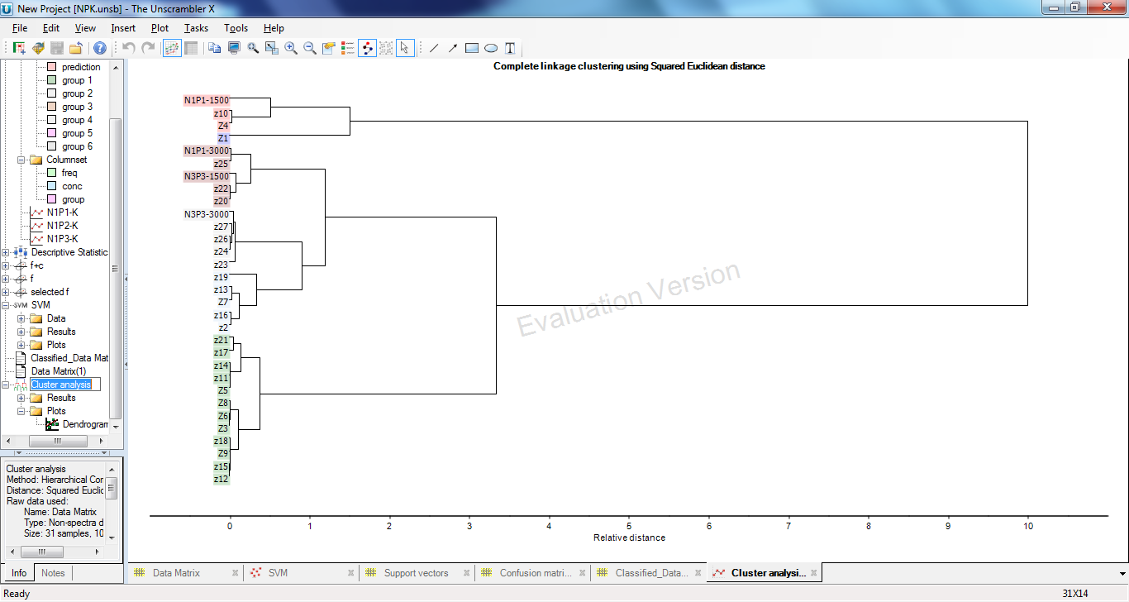
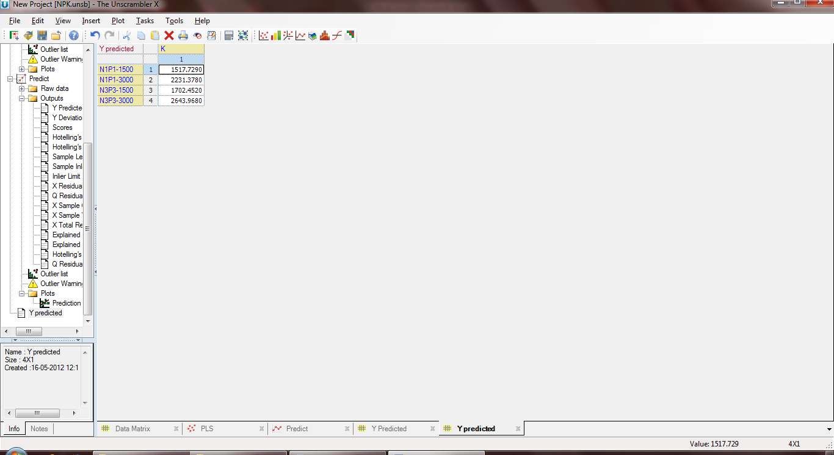
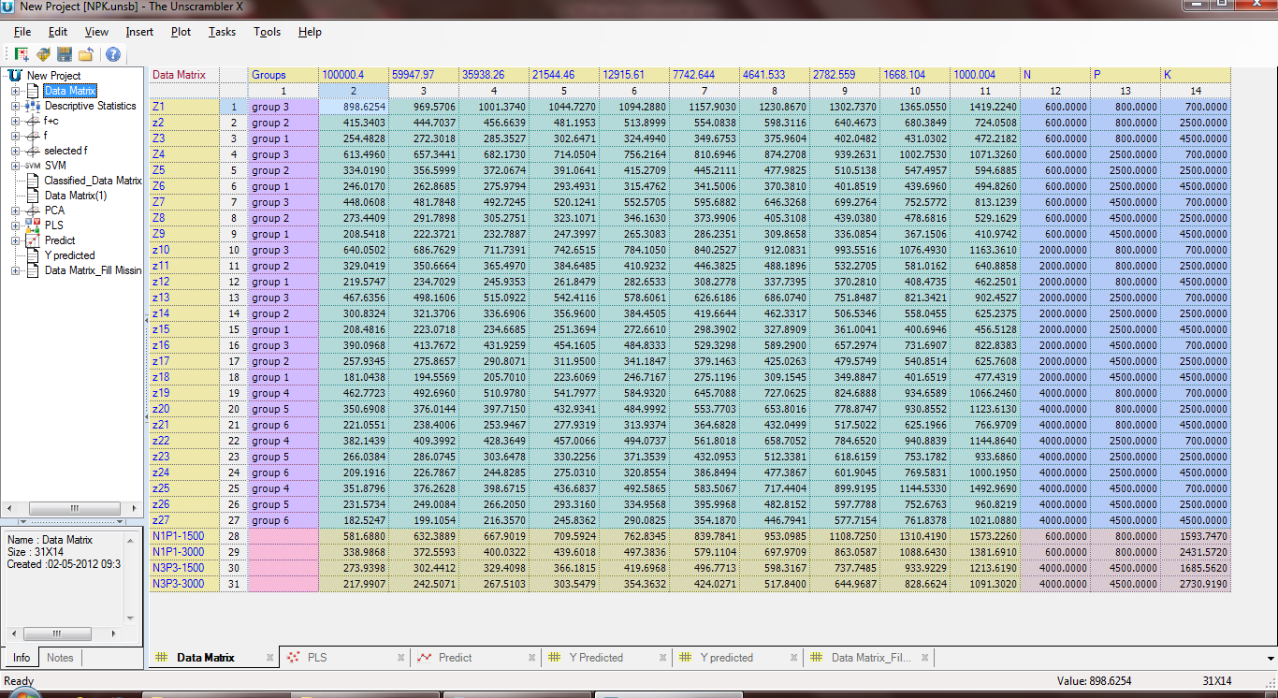
Results & discussions of Regression Analysis performed
Regression analysis is done through following two methods:
Prediction
Fill Missing Value
SAMPLES | ACCURATE VALUES | ESTIMATED VALUES
N1P1-1500 | 1500 | 1517.7290
N1P1-3000 | 3000 | 2231.3780
N3P3-1500 | 1500 | 1702.4520
N3P3-3000 | 3000 | 2643.9680
SAMPLES | ACCURATE VALUES | ESTIMATED VALUES
N1P1-1500 | 1500 | 1593.747
N1P1-3000 | 3000 | 2431.572
N3P3-1500 | 1500 | 1685.562
N3P3-3000 | 3000 | 2730.919
PREDICTION BASED ON PLS MODEL
FILL MISSING VALUES

Slide 18
Conclusion
In this work, different macronutrients like N, P & K are predicted with the help of 27 samples & the responses of the samples are studied at different frequencies and compared for their discriminability.
The correlations between the frequency specific impedance response of working electrodes and the chemical concentrations which depend on sample variability have been established.
Various prediction, classification & clustering techniques were applied which resulted in the 75% accuracy of the results.
Successful implementation for lab testing.

Slide 19

This project has been successfully implemented for lab testing but the real test will be when the actual soil samples will be predicted & the results are validated. If the results are found to be correct then the model will be programmed & the actual soil sensor can be developed.
This is a first of its kind work & can be set as a benchmark for further research work to be carried in this domain.
Research paper will be published of this work & the manuscript is ready.

Slide 20



